Slide 1
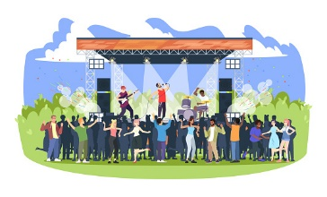
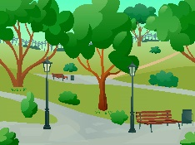
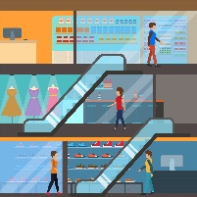
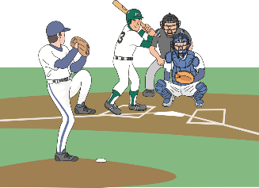
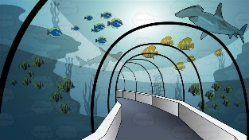
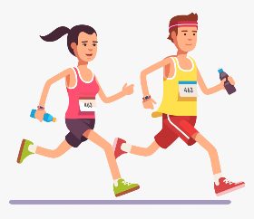
1 | School
2 | Park
3 | Mall
4 | Zoo
5 | Aquarium
A | The Concert
B | The Baseball Game
C | The sale
D | The marathon

Slide 2
１A | 1A | 1B | 1B | 1C | 1C | 2A | 2A | 2B | 2B
4A | 4A | 3C | 3C | 3B | 3B | 3A | 3A | 2C | 2C
4B | 4B | 4C | 4C | 5A | 5A | 5B | 5B | 5C | 5C
1D | 1D | 2D | 2D | 3D | 3D | 4D | 4D | 5D | 5D

