Slide 1
Could you…?
Tamatsu JHS

Slide 2
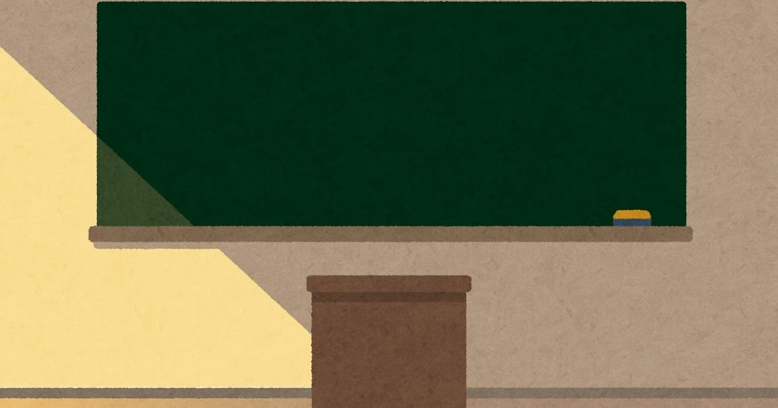
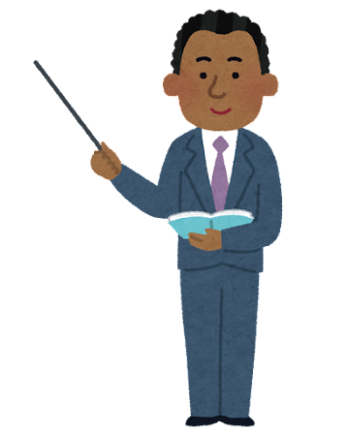
Today we are going to learn about different types of foods.

Slide 3
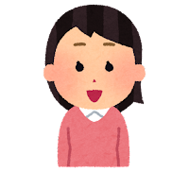
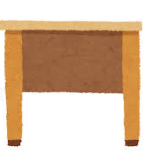
I can’t hear what he is saying. He’s speaking too quietly.

Slide 4
Sensei! ______________________
_____________________
Could you
please speak a little louder?

Slide 5
!

Slide 6
Oh! Of course, so I was saying that today we are going to…...

