Slide 1
Line

Slide 2
Doughnut

Slide 3
Row

Slide 4
Change Position

Slide 5
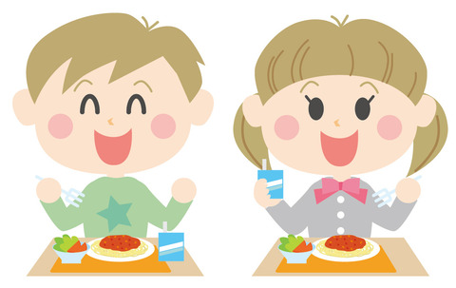
Lunch Group

Slide 6
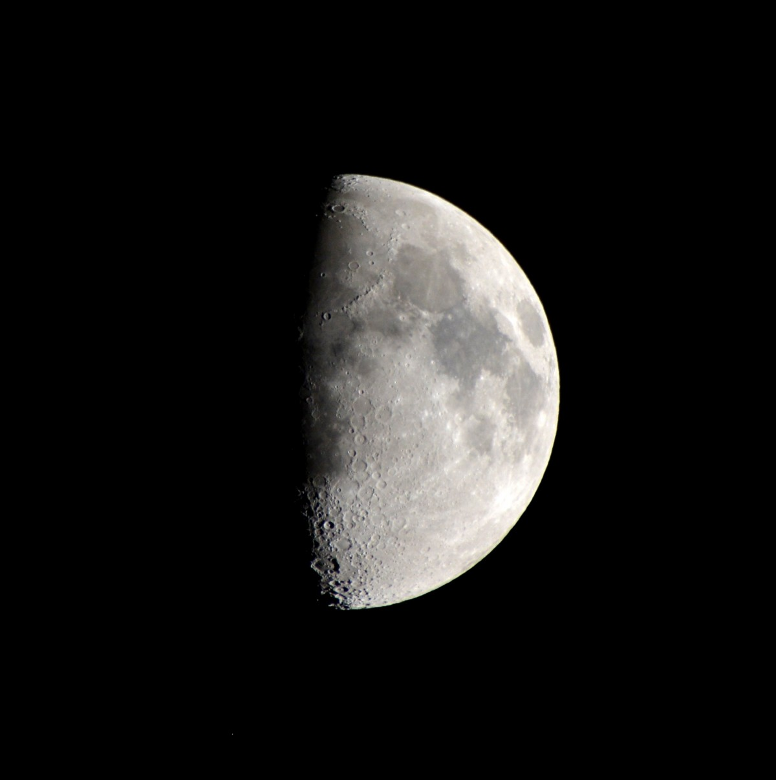
Half

