Slide 1
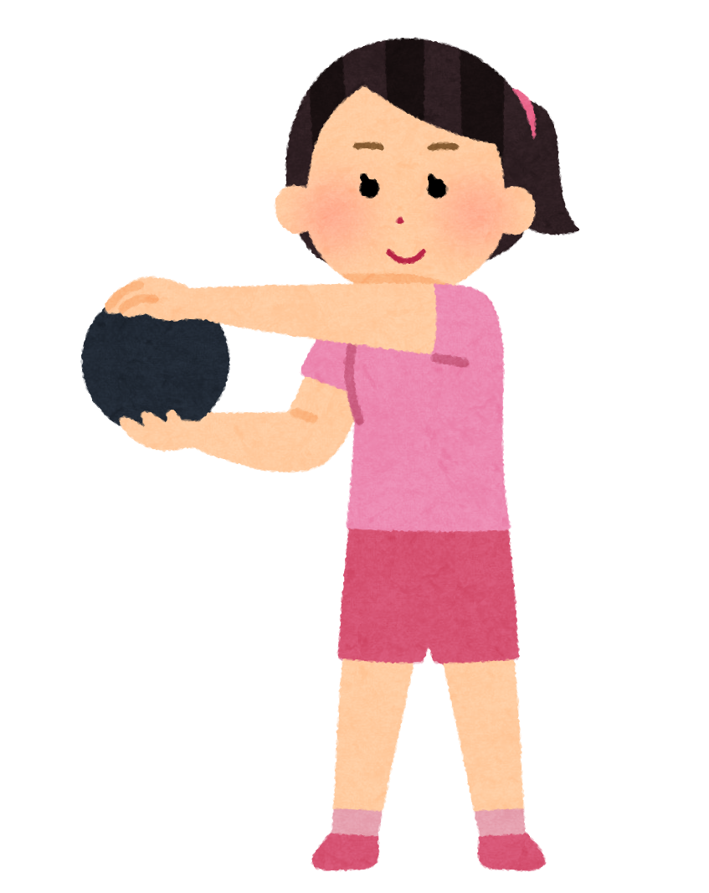
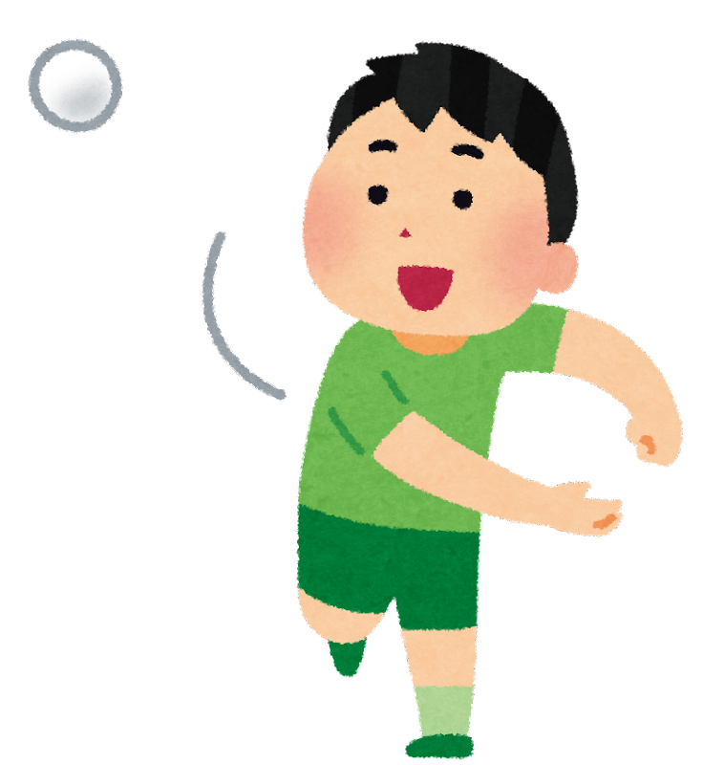
How do we play?
Throw the ball to anyone! Keep passing the ball around. When the teacher pauses the music, you need to answer a question in English. Do your best! If you answer correctly, you will get a sticker.
QUESTION
QUESTION
What languages can you speak?
Which animal is better, cats or dogs?
QUESTION
QUESTION
What country do you want to visit?
What is your hobby?
QUESTION
QUESTION
How old are you?
Which subject do you like the best?
QUESTION
QUESTION
Which animal do you like best?
What time is it right now?
QUESTION
QUESTION
What month is it now?
What day is today?
How is the weather today?
QUESTION
QUESTION
Who is your favorite character?
Notes:
Best songs to play: Safe and Sound by Capital Cities, Good Time by Carly Rae Jepsen, Try Everything by Shakira, #thatPower by will.i.am, Happy by Pharrell Williams, Dynamite by BTS

Slide 2
How do we play?
Throw the ball to anyone! Keep passing the ball around. When the teacher pauses the music, you need to answer a question in English. Do your best! If you answer correctly, you will get a sticker.
QUESTION
QUESTION
How did you get to school today?
Which holiday do you like the best?
QUESTION
QUESTION
Which club are you in?
What is your homeroom teacher’s name?
QUESTION
What food do you want to eat?
QUESTION
Which foods can you cook?
QUESTION
Where were you born?
QUESTION
What makes you happy?
QUESTION
QUESTION
Do you have any brothers or sisters?
Which drink is the best?
QUESTION
Please spell your name.
QUESTION
Which season is better, fall or spring?

