Slide 1
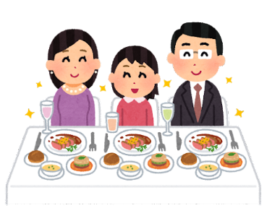
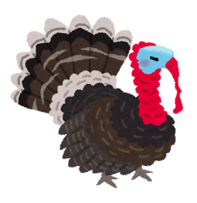
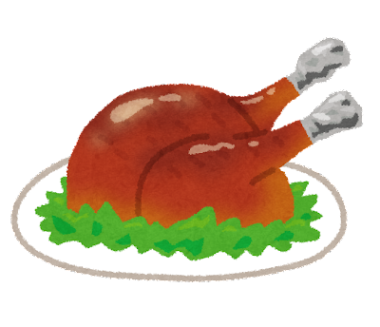
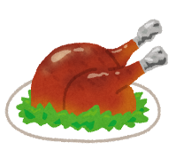
Thanksgiving Word Search
T H A N K S G I V I N G U Q T H F M I N L E F H
R X H O L I D A Y R A G
K W L I A P F K F D M F
E U J P E J D J O P I R Y F E A S T S F O T L T
P M N R Q D A L D Q Y Y
THANKSGIVING HOLIDAY FEAST TURKEY FAMILY FOOD

Slide 2
Thanksgiving Word Search
T H A N K S G I V I N G U Q T H F M I N L E F H
R X H O L I D A Y R A G
K W L I A P F K F D M F
E U J P E J D J O P I R Y F E A S T S F O T L T
P M N R Q D A L D Q Y Y
THANKSGIVING HOLIDAY FEAST TURKEY FAMILY FOOD

