Slide 1
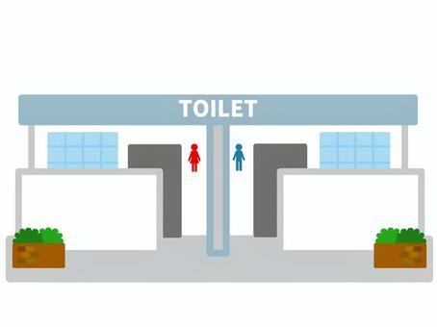

Slide 2
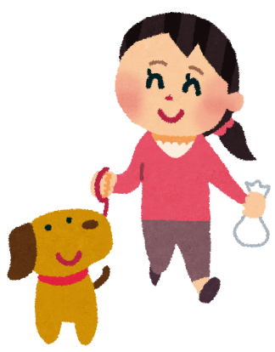
woman walking her dog

Slide 3
bird

Slide 4
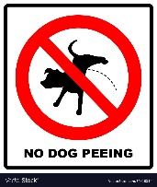
sign

Slide 5
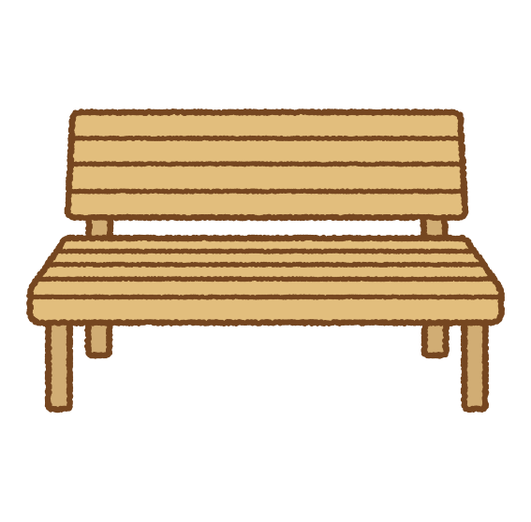
bench

Slide 6
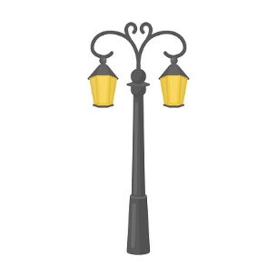
light

Slide 7
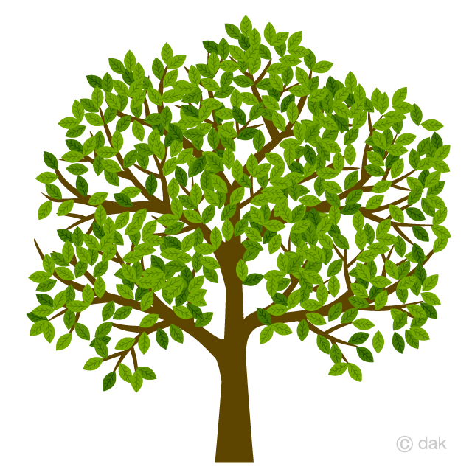
tree

Slide 8
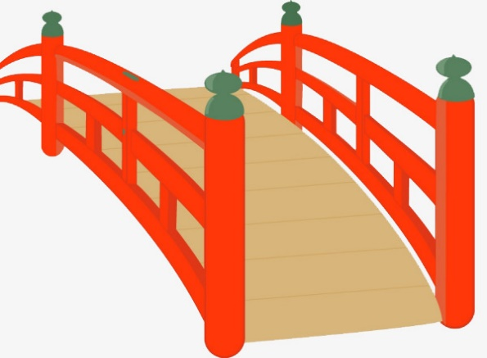
bridge

Slide 9
bin

Slide 10
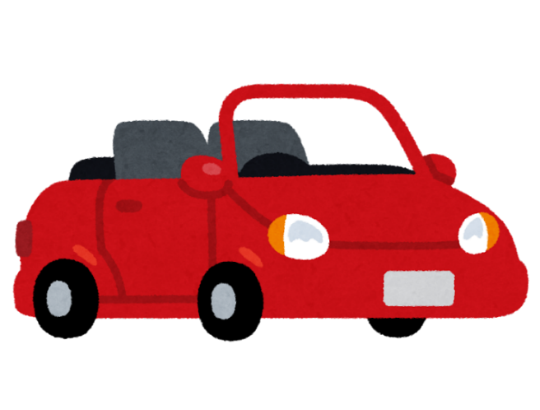
car

Slide 11
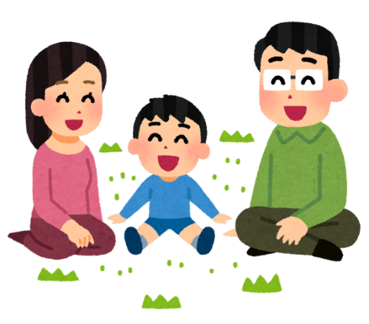
family

Slide 12
The woman with her dog is in front of the toilet. The car is near the bridge. The bird is on the bridge. The bench is next to the tree. The lightpost. is next to the bench. The bin is behind the family. The “No dog peeing” sign is on the lightpost.

Slide 14
The tree is between the family and the bench. The light post is next to the bench. The woman is walking her dog on the bridge. The bird is on the tree. The car is infront of the toilet. The trash bin is near the toilet. The No Dog sign is posted on the bench.

Slide 15
The car

Slide 16
The woman with her dog is in front of the car. The lightpost is infront of the toilet. The bird is on the lightpost. The bench is near the bin. The bridge is near the toilet The sign is on the bridge.

