Slide 1
In the objects menu you can select this thing for making clean easy squares.

Slide 2
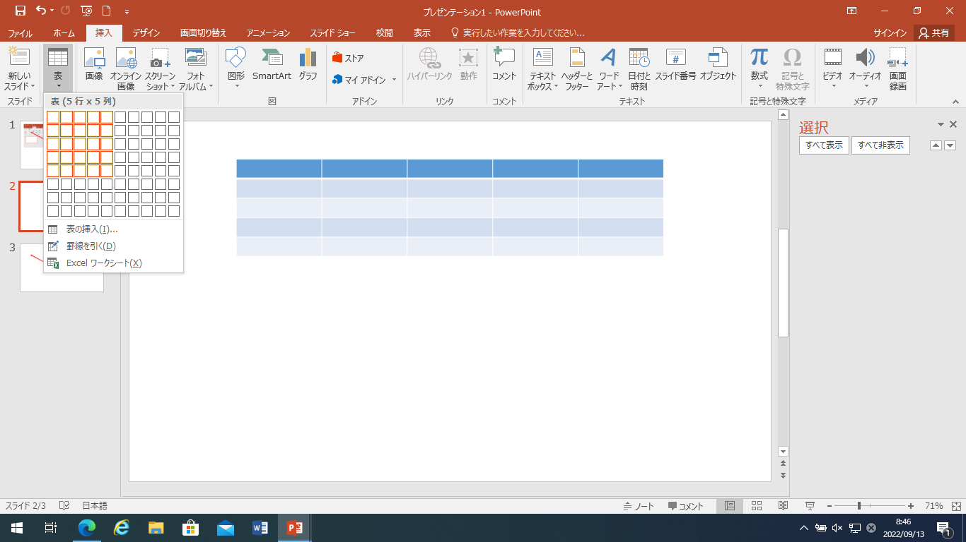
Choose however many squares you like.

Slide 3
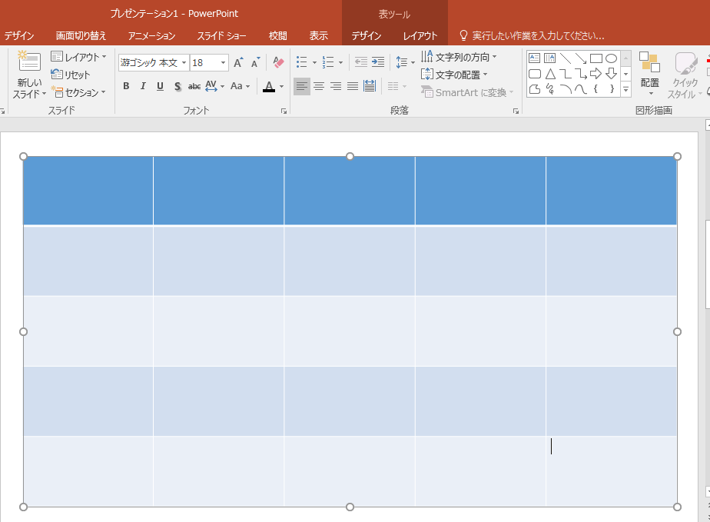
Then select the grid and stretch it out to whatever size you like.

Slide 4
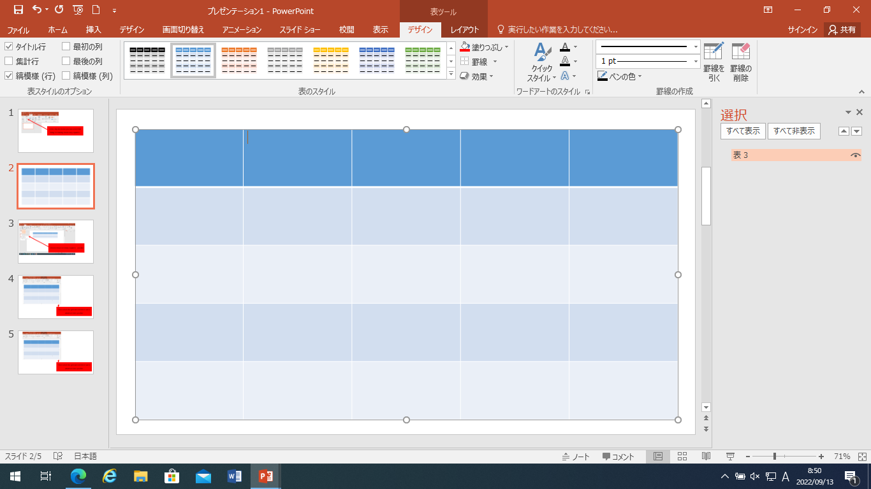
Keep it selected then go up to the design menu and scroll down to find this design.

Slide 5
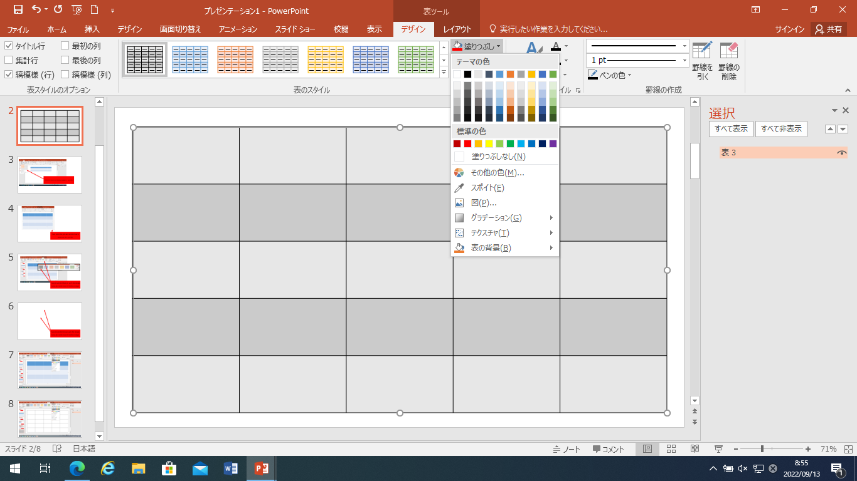
Still keeping the grid selected go to the fill menu and select white or no fill.

Slide 6
Then I’d put the text on in boxes with white frames that fit in the grid with pictures.
The grammar
text
text
text
text
text
text
text
text
text
text

Slide 7
Animations in the boxes
The grammar
text
text
text
text
text
X
0
X
0
X
0
X
0
X
0
text
X
0
X
0
X
0
X
0
X
0
text
X
0
X
0
X
0
X
0
X
0
text
X
0
X
0
X
0
X
0
X
0
text
X
0
X
X
0
0
X
0
X
0
text

