Slide 1
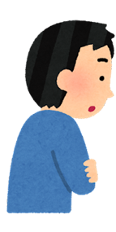
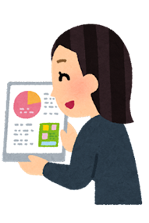
タブレットで調べる！
My name is _____________________________ Class 2の__ Date __________________
1 per student
Conversation (会話)
生徒: Number 1, please.
先生: Can you tell me where to buy bread?
生徒: Yes. I can tell you where to buy bread.
You can buy bread (atかin) Panya no Panda.
f
○○を動詞
○○を動詞
Local bakery
○○を動詞
どこで/何国
西条市に (In Saijo)
Your city
1. Can you tell me where to buy bread? 答え: __________ | 2. Can you tell me where to eat ramen? 答え: __________ | 3. Can you tell me where to enjoy sushi? 答え: __________
Panya no Panda
外国に (Abroad)
4. Can you tell me where to see the northern lights? 答え: __________ | 5. Can you tell me where to see the Grand Canyon? 答え: __________ | 6. Can you tell me where to see the Nazca Lines? 答え: __________
7. Can you tell me where to drink a mango lassi? 答え: __________ | 8. Can you tell me where to eat tacos? 答え: __________ | 9. Can you tell me where to watch a haka dance? 答え: __________
ノーザーン ライツ
グランド キャニョン
ナズカー ラインズ
タコーズ
マンゴー ラシー
ハカー

Slide 2
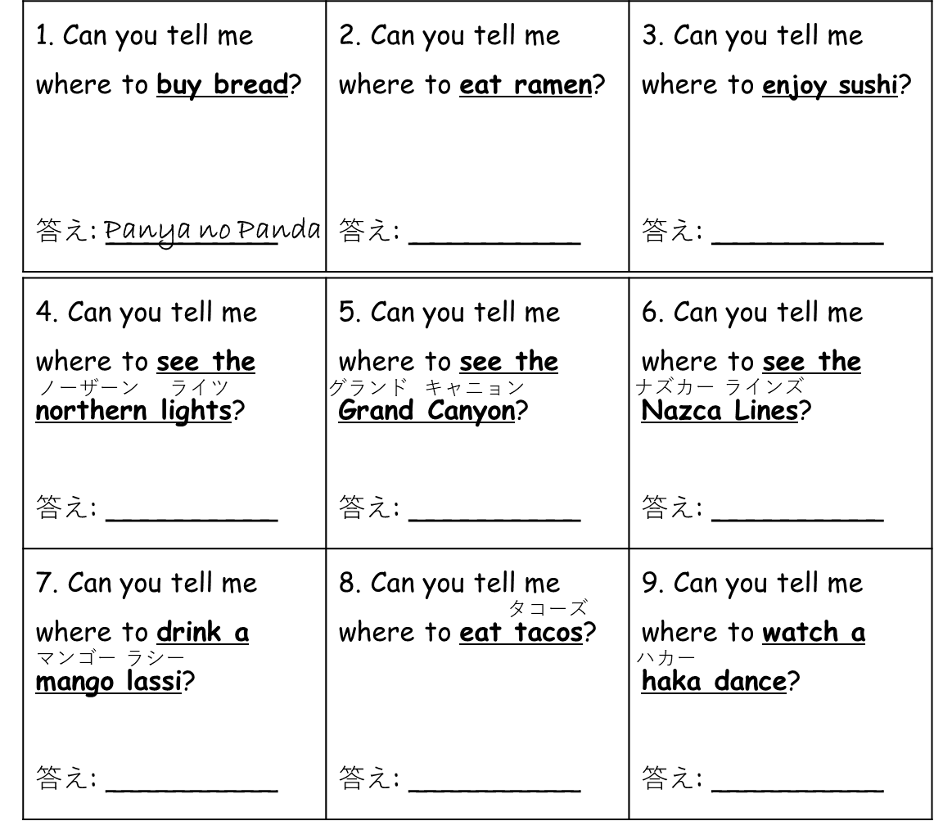
I print this out on colored paper and cut in half.
1 per group

