Slide 1
Unit 8 Review (be + ～ing)

Slide 2
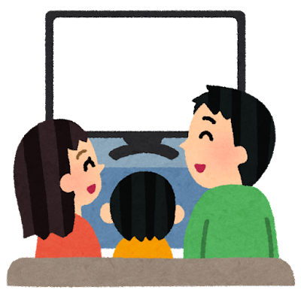
Story ① Key Sentence 31
We are…
I watch TV.
I am watching TV.
私はテレビを見る
私はテレビを見ている
He・She watching TV.
They・We watching TV.
He is…
She is…
I am…
<am [are, is] + ～ing>の形を復習しましょう！

Slide 3
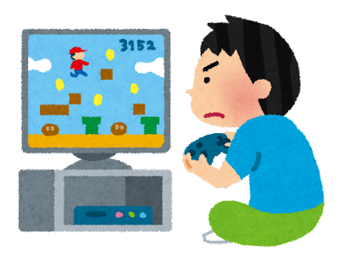
He・She [be] ～ing
Rule:
When you see he or she, please use “is”!
He（彼）かShe（彼女）があったら、「is」を使ってください！
He is watching TV
She is watching TV
What is he doing?
He / play / games.
He is playing games.

Slide 4
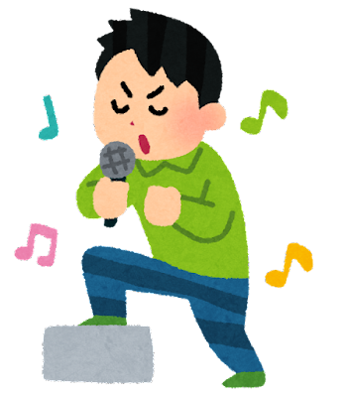
We・They [be] ～ing
Rule:
When there is more than one person, please use “are”!
1人以上がいったら、「are」を使ってください！
We=私たち / They=彼ら / Luffy and Gojo and Naruto / など
What are they doing?
They / sing / karaoke
They are singing karaoke.

Slide 5
Let’s play Sentence Scramble!
You will get some cards with words. Please arrange the words in the correct order.
You will have extra cards, so please pay attention to the am/is/are rule we reviewed.
Let’s try!
We
am
is
Meg and Kaito
swimming
She

