Slide 1
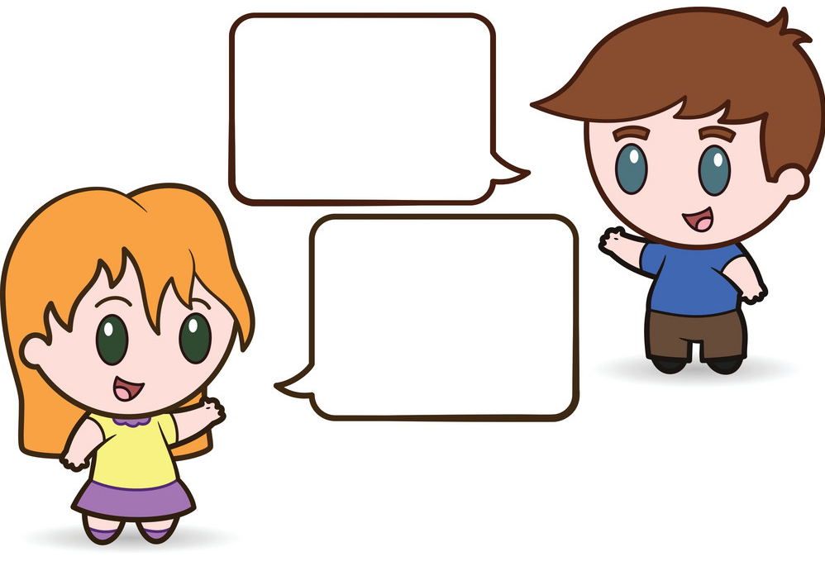

Slide 2
CHOOSE ONE LETTER

Slide 3
MYSTERY QUESTIONS
3
1
5
2
4

Slide 4
INTRODUCE YOURSELF
My name is _______________.
My birthday is on _______________.
I am _________ years old.
My name is Naruto Uzumaki.
My birthday is on October 10.
I am 12 years old.

Slide 5
TELL SOMETHING ABOUT YOURSELF
(food, sport, subject, game, animal, color, things)
I like _______.
I have ______.
I want ______.
I play ______.
I have many toys.
I want to buy Iphone 13.
CHOOSE TWO

Slide 6
MY VACATION –Summer or Winter (enjoyed, saw, ate, visited, made)
Last ________, I went to _________.
I __________.
It was fun/great/interesting!
Last summer, I went to Kyoto.
I visited Fushimi Inari Taisha Temple.
It was interesting!

Slide 7
MY TOWN – KOBE (visit, see, enjoy, buy, drink, eat, play)
In ________, we have _______.
You can ________.
In Kobe, we have hot springs.
You can visit Arima Onsen.

Slide 8
MY BEST MEMORY (sports day, graduation day, field trip, school trip, swimming meet, music festival, drama festival, entrance ceremony, volunteer day)
My best memory is ________. We _________.
My best memory is our volunteer day. We picked up garbage at a park.

