Slide 1
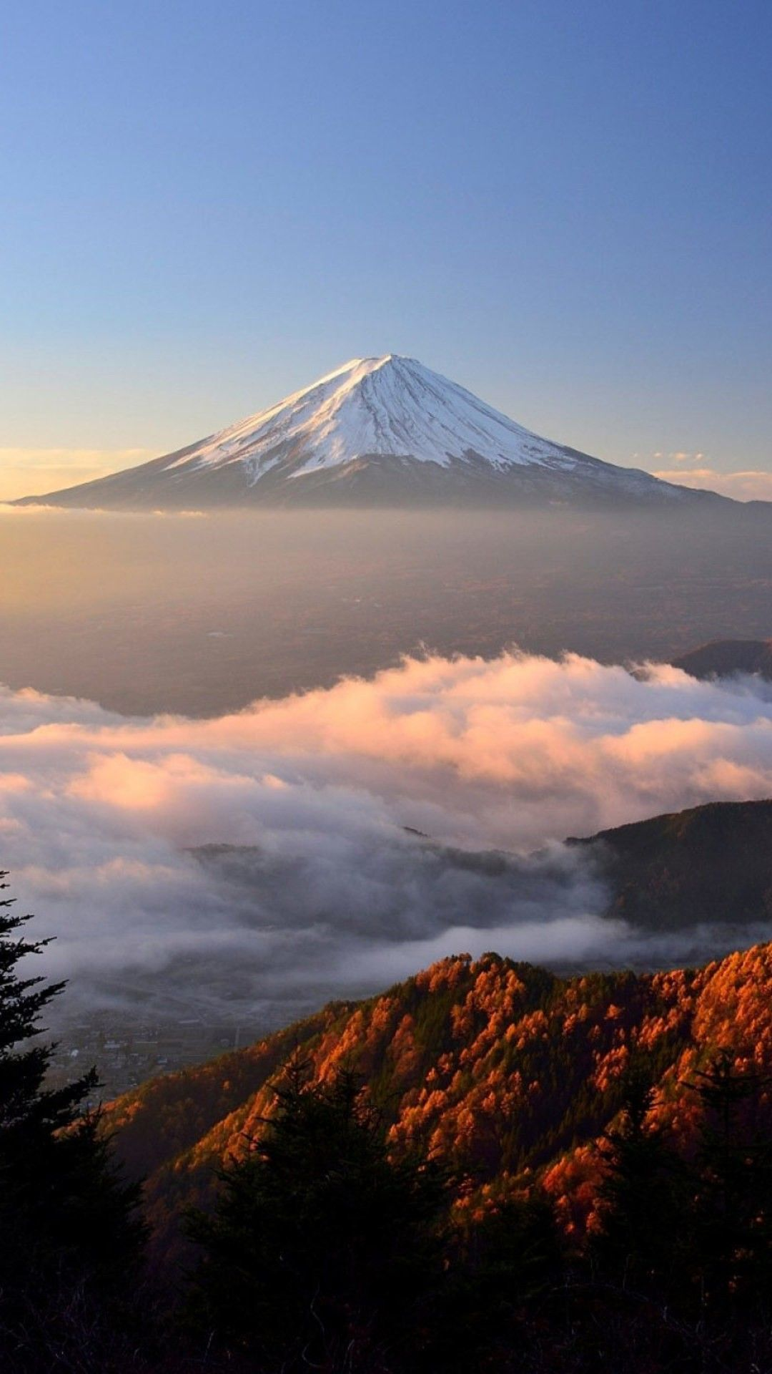
Class:______ No.: ______ Name: __________________________
Let’s Climb Mt. Fuji!
仲間と一緒に、富士山への旅行を計画しています。どのコースで行くのか、いつ行くのか、何を持って行くのかを決めてください。なぜこのような決定をしたのか説明してください。
In a group, you and your friends are planning a trip to Mt. Fuji. Decide which trail to take, when during the year you will go, and what you will bring. Explain why you made these decisions.
___________________________________________________________________________________________________
___________________________________________________________________________________________________
___________________________________________________________________________________________________
___________________________________________________________________________________________________
___________________________________________________________________________________________________
___________________________________________________________________________________________________
___________________________________________________________________________________________________
___________________________________________________________________________________________________
___________________________________________________________________________________________________
___________________________________________________________________________________________________
___________________________________________________________________________________________________
___________________________________________________________________________________________________

