Slide 1
Rod is in the stadium

Slide 2
Bec is buying showbags.

Slide 3
Keith isn’t riding a roller coaster.

Slide 4
Jacob is riding a horse in the paddock.

Slide 5
Mary isn’t eating cake.

Slide 6
Keith and Mary aren’t drinking wine.

Slide 7
Keith is in the garden.

Slide 8
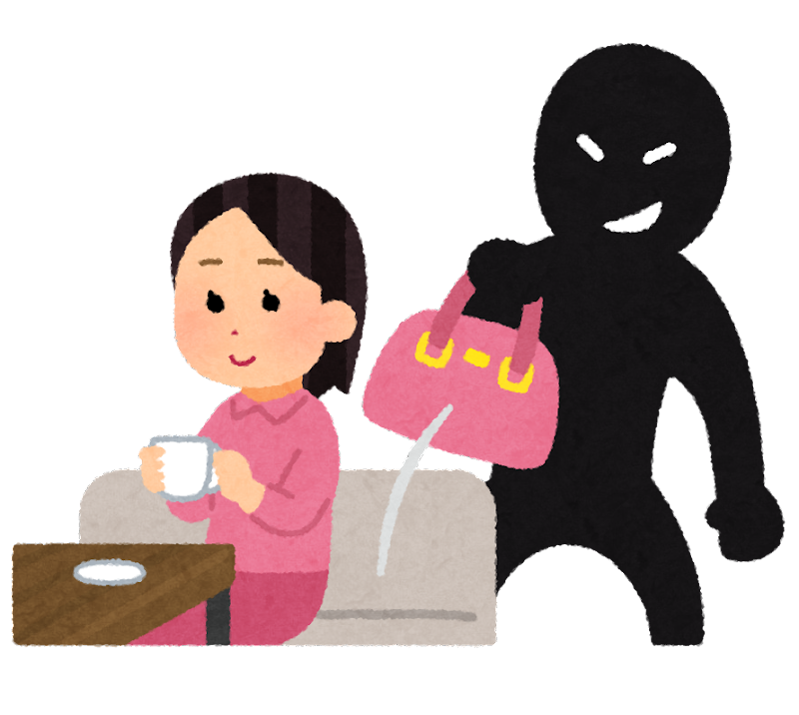
The thief is in the café.

Slide 9
Bec is in the pavilion.

Slide 10
Rod is eating cake.

Slide 11
John isn’t buying showbags.

Slide 12
Mary isn’t in the café or the stadium.

Slide 13
The thief is drinking wine.

Slide 14
Mary isn’t watching woodchopping.

Slide 15
John isn’t in the garden.

