Slide 1
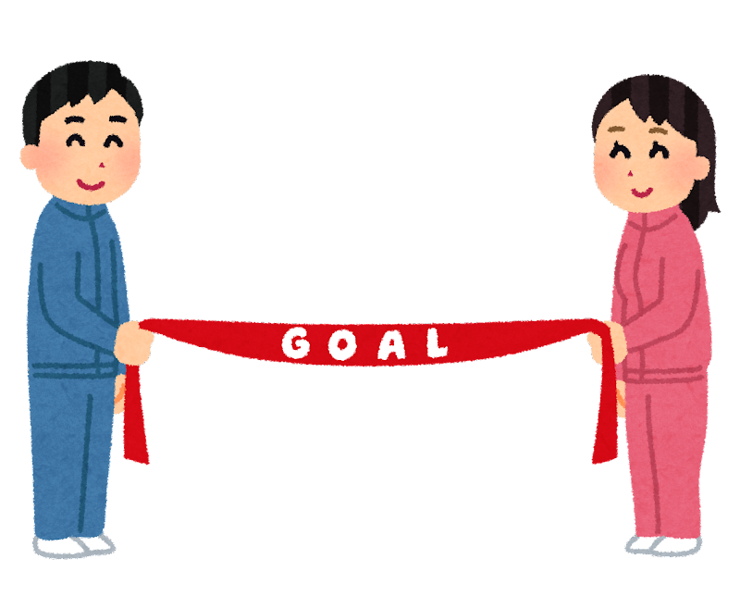
Something you must do to be healthy
Something you must not do in a restaurant
Something you have to do everyday
Something you don’t have to do on vacation
Go back to start
Something you have to do in the morning
Go back one space
Something your parents won’t let you do
Something you must do before a test
Something you don’t have to do while you sleep
Something you must bring to school
Something you must not do in a theater
Something a teacher has to do before class
Something you don’t have to do today
Something you don’t have to do tomorrow
Something you have to take with you when you travel
Something you must not do in school
Where must you go after school?
Go back two spaces
Go back to start
Something you must do before dinner
Something you must not do in a library
Something you have to do after this class

