Slide 1
Vocabulary Quiz!

Slide 2
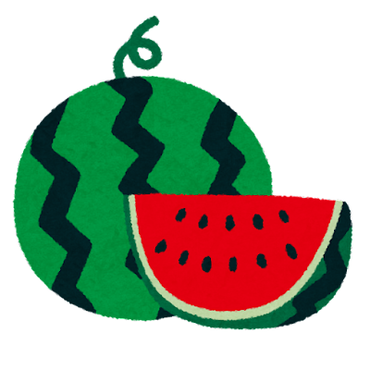
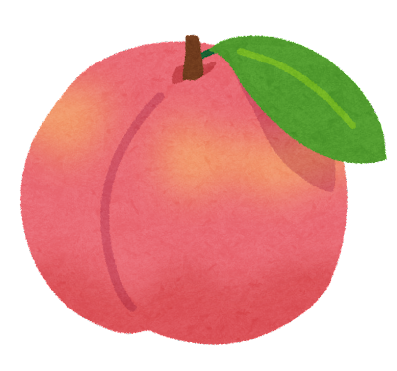
Vocabulary
りんご | ぶどう | 桃 | いちご | レモン | すいか | さくらんぼ
apple
grapes
peach
strawberry
lemon
watermelon
cherry

Slide 3
READY?

Slide 4
In Japan, we ( ) a lot of rain in fall.
1. have 2. give 3. make 4. move
-2
0
5
1
2
3
-1

Slide 5
A: Which is Naomi’s new bicycle?
B: The red one is (she).
hers
4
2
1
-3
5
3
0

Slide 6
A: ( ) bag is this?
B: It’s mine.
1. which 2. where 3. when 4. whose
3
4
-2
1
-1
0
2

Slide 7
A: I hear you are going to Australia this summer.
B: Yes. I’m going to study English.
A: ( ) you excited?
1. do 2. are 3. have 4. can
1
3
-2
5
2
-1
1

Slide 8
We can get new ideas by ( ) with a lot of people.
1. talking 2. talked 3. have talked 4. to talk
-2
0
5
1
2
3
-1

Slide 9
A: What are you looking for?
B: I’m looking for my pen.
A: If you can’t find your pen, please use ( ).
1. your 2. my 3. yours 4. mine
0
-3
-1
2
4
1
5

Slide 10
A: This song had (be) famous for a long time.
B: Yes, my grandfather sometimes listens to it.
been
4
2
1
-3
5
3
0

Slide 11
A: Excuse me. I want a hamburger and an orange juice, please.
B: OK. Anything else?
Yes, I was. 2. Yes, they are.
3. No, it’s not. 4. No that’s all.
1
2
3
0
3
2
1

Slide 12
A: Nancy, ( ) your music class start at ten?
B: No, at eleven.
do 2. does 3. is 4. are
1
2
3
0
3
2
1

Slide 13
Shizuoka is famous ( ) its nice tea.
1. as 2. in 3. on 4. for
0
2
3
4
-2
-1
1

Slide 14
A: It has stopped (r ) tonight.
B: Good. I can go home without an umbrella.
raining
2
3
5
0
1
4
-1

Slide 15
I have been in London ( ) two weeks.
1. for 2. from 3. near 4. with
-1
2
-1
2
-1
2
2

Slide 16
A: What did you borrow from the library?
B: Botchan. It is the book (wrote) by Soseki Natsume.
written
2
3
0
5
1
4
-1

Slide 17
Because of AI, we may lose some of our jobs and ( ) doing things we are doing now.
1. like 2. start 3. enjoy 4. stop
2
5
-2
1
0
3
-1

Slide 18
A: You’ll play for the piano contest tomorrow. Good luck.
B: Thank you. I’ll do my ( ).
best
3
3
3
3
3
3
3

Slide 19
I haven’t (see) you for a few days.
seen
2
3
0
5
1
4
-1

Slide 20
Last week, I climbed a mountain ( ) with snow.
1. cover 2. covered 3. covering
0
2
1
-2
3
5
4

Slide 21
A: Which would you like to drink, coffee or tea?
B: Oh, it’s difficult to choose because I like ( ) coffee and tea.
both
2
3
0
5
1
4
-1

