Slide 1
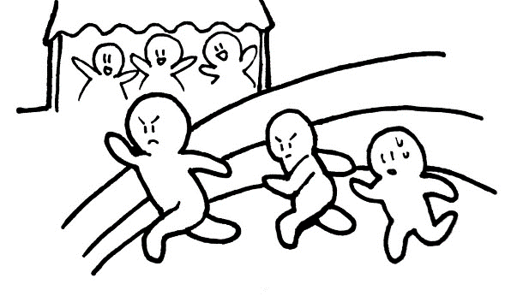
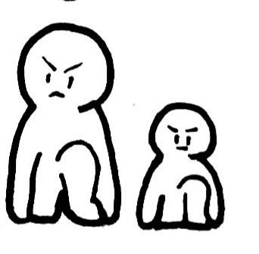
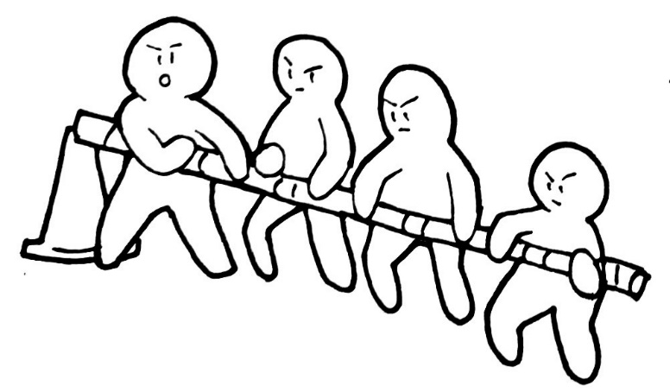
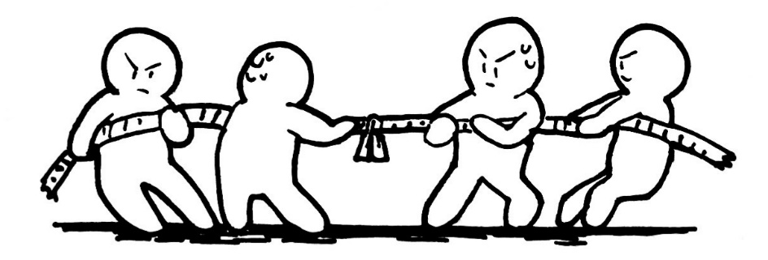
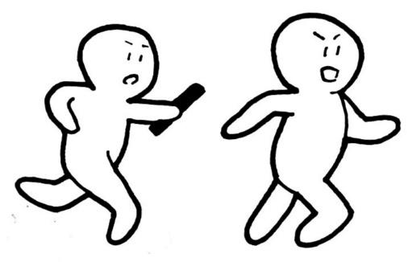
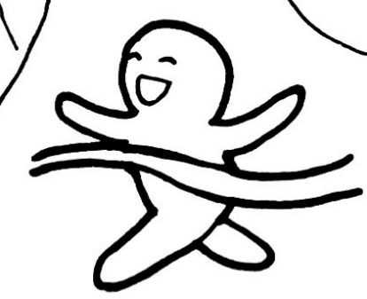
Go Orange Team
Go Yellow Team
START
HIP Hip HOORAY!!
SPEED!!
Go Red Team
Go Pink Team
Don't stop!!!
TEAM WORK!!
STRENGTH!!
Go!!
Go!!
Go!!
Ganbare
[ SCHOOL NAME] Students!!!!
FINISH
Go Green Team
Which team will be the champions?
Go White Team
Go Blue Team
WAVE YOUR FLAG!!
IN IT TO WIN IT!!!
YOU CAN DO IT!!!!!!

Slide 2
START
HIP Hip HOORAY!!
SPEED!!
Go Yellow Team
Go Red Team
Don't stop!!!
TEAM WORK!!
STRENGTH!!
Go!!
Go!!
Go!!
Ganbare
[SCHOOL NAME] Students!!!!
FINISH
Go Green Team
Which team will be the champions?
Go Blue Team
WAVE YOUR FLAG!!
IN IT TO WIN IT!!!
YOU CAN DO IT!!!!!!

